Slide 1

Computational Structures in Data Science
UC Berkeley EECS Lecturer Michael Ball
Lecture #23 & 24: Databases & SQL
April 20, 2020
https://cs88.org/

Slide 2
Updates
Nick Weaver will give a guest lecture on Monday. It will be fun!
Final Exam:
https://piazza.com/class/k5kga9pwx0l754?cid=877
Please fill out the form linked to pick which time
You can not take the final if you don’t need the points…
Reminder:
We lowered the grading bins. There’s a big gap at both the B- and C- rages to account for P/NP and S/U (grad students). The same grading scheme applies to everyone.
We are not curving the course, just earn the points you need! But if grades are still really low, we might adjust bins but don’t expect to.
Please, please, please fill out course evals!
https://course-evaluations.berkeley.edu
The more you tell us, the more you help future students!

Slide 3
Why Databases?
• Data lives in files: website access logs, in images, in CSVs and so on…
• This is an amazing source, but hard to access, aggregate and compute results with.
• Databases provide a mechanism to store vast amounts of data in an organized manner.
• The (often) rely on ”tables” as an abstraction. We
• There are other kinds of databases, that store “documents” or other forms of data.
• This stuff is the topic of CS186

Slide 4
Why SQL?
SQL is a declarative programming language for accessing and modifying data in a relational database.
It is an entirely new way of thinking (“new” in 1970, and new to you now!) that specifies what should happen, but not how it should happen.
One of a few major programming paradigms
Imperative/Procedural
Object Oriented
Functional
Declarative

Slide 5
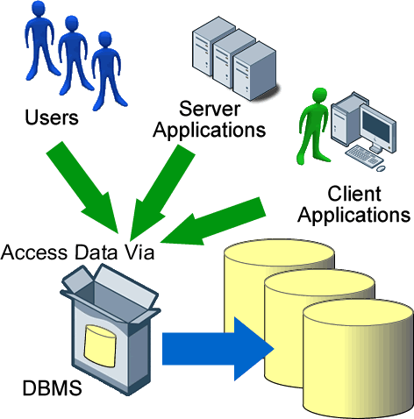
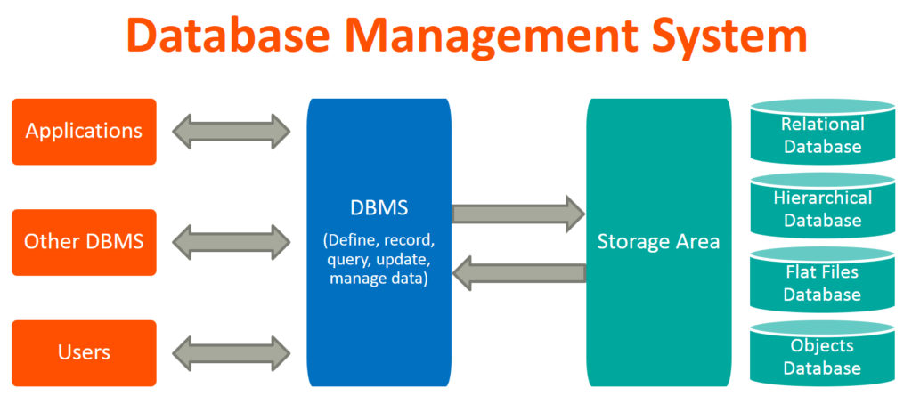
Database Management Systems

Slide 6
App in program language issues queries to a database interpreter
User
Application
Classes & Objects
Database Query Processor,
i.e., Interpreter
Response
Tables
Python Interpreter
SQL query
The SQL language is represented in query strings delivered to a DB backend.
Use the techniques learned here to build clean abstractions.
You have already learned the relational operators!

Slide 7

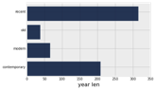
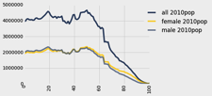
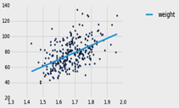
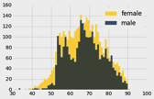
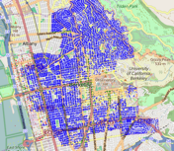
Data 8 Tables
ordered collection of labeled columns of anything
label
select, where, take, drop, group
stats, bin
sample
dict, record,tuple
pivot, pivot_bin
values
split
join
Numpy array
T[‘label’]
A single, simple, powerful data structure for all
Inspired by Excel, SQL, R, Pandas, Numpy, …

Slide 8
Database Management Systems
DBMS are persistent tables with powerful relational operators
Important, heavily used, interesting!
A table is a collection of records, which are rows that have a value for each column
Structure Query Language (SQL) is a declarative programming language describing operations on tables
column has a name and a type
row has a value for each column
Name | Latitude | Longitude
Berkeley | 38 | 122
Cambridge | 42 | 71
Minneapolis | 45 | 93
table has columns and rows

Slide 9
SQL
A declarative language
Described what to compute
Imperative languages, like python, describe how to compute it
Query processor (interpreter) chooses which of many equivalent query plans to execute to perform the SQL statements
ANSI and ISO standard, but many variants
This SQL will work on most databases.
SELECT statement creates a new table, either from scratch or by projecting a table
create table statement gives a global name to a table
Lots of other statements
analyze, delete, explain, insert, replace, update, …
The action is in select

Slide 10
SQL example
SQL statements create tables
Give it a try with sqlite3 or http://kripken.github.io/sql.js/GUI/
Each statement ends with ‘;’
culler$ sqlite3
SQLite version 3.9.2 2015-11-02 18:31:45
Enter ".help" for usage hints.
Connected to a transient in-memory database.
Use ".open FILENAME" to reopen on a persistent database.
sqlite> select 38 as latitude, 122 as longitude, "Berkeley" as name;
38|122|Berkeley
sqlite>

Slide 11
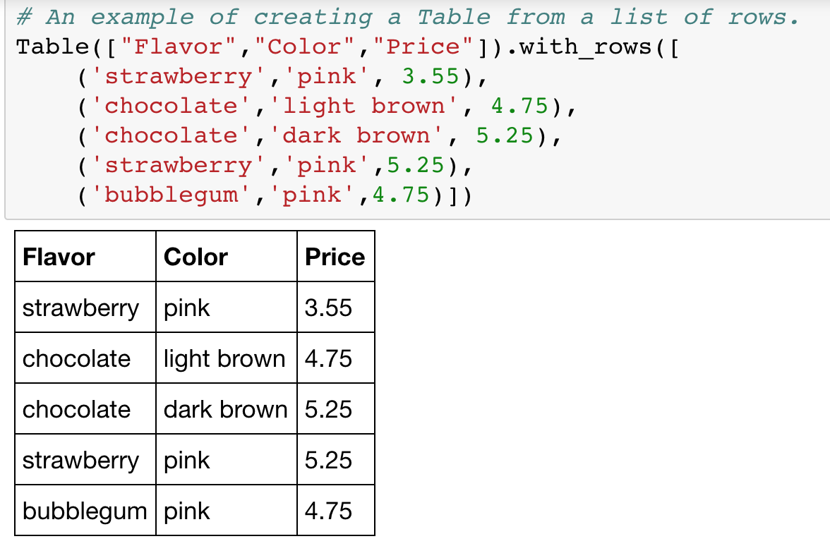

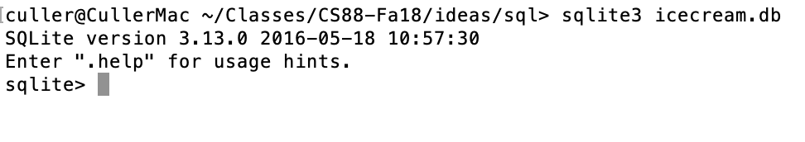
A Running example from Data 8 Lec 10

Slide 12
select
Comma-separated list of column descriptions
Column description is an expression, optionally followed by as and a column name
Selecting literals creates a one-row table
union of select statements is a table containing the union of the rows
select [expression] as [name], [expression] as [name]; . . .
select "strawberry" as Flavor, "pink" as Color, 3.55 as Price;
select "strawberry" as Flavor, "pink" as Color, 3.55 as Price union
select "chocolate","light brown", 4.75 union
select "chocolate","dark brown", 5.25 union
select "strawberry","pink",5.25 union
select "bubblegum","pink",4.75;

Slide 13
create table
SQL often used interactively
Result of select displayed to the user, but not stored
Create table statement gives the result a name
Like a variable, but for a permanent object
create table [name] as [select statement];

Slide 14
SQL: creating a named table
create table cones as
select 1 as ID, "strawberry" as Flavor, "pink" as Color, 3.55 as Price union
select 2, "chocolate","light brown", 4.75 union
select 3, "chocolate","dark brown", 5.25 union
select 4, "strawberry","pink",5.25 union
select 5, "bubblegum","pink",4.75 union
select 6, "chocolate", "dark brown", 5.25;
Notice how column names are introduced and implicit later on.

Slide 15
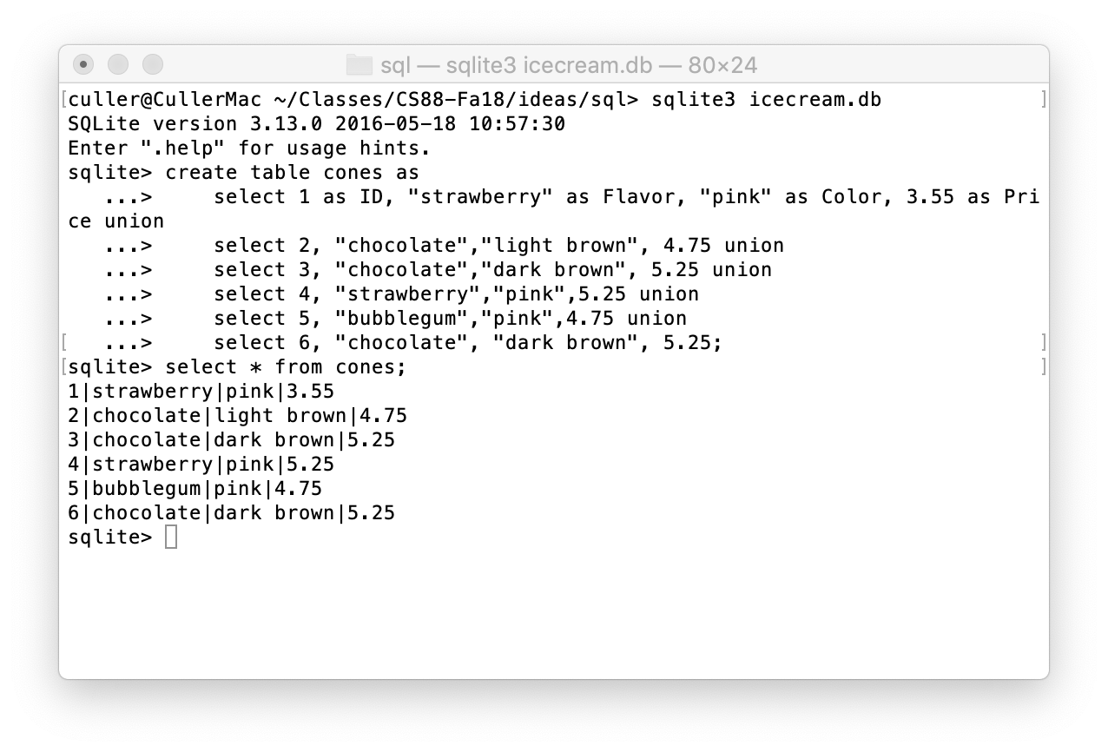
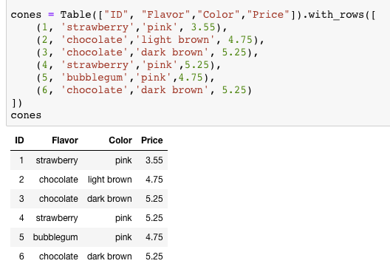
Select …

Slide 16
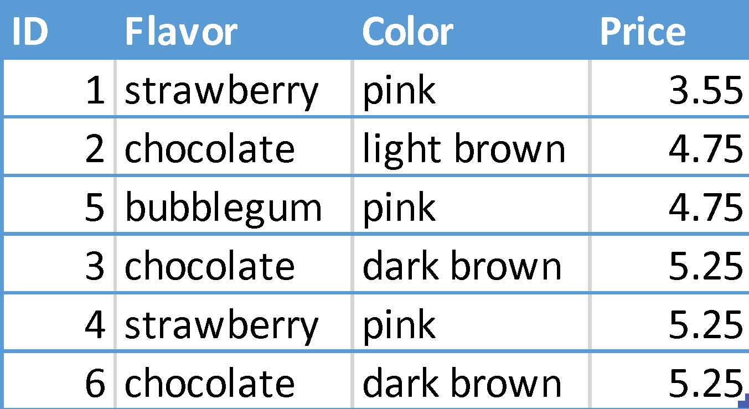
Projecting existing tables
Input table specified by from clause
Subset of rows selected using a where clause
Ordering of the selected rows declared using an order by clause
select [columns] from [table] where [condition] order by [order] ;
select * from cones order by Price;

Slide 17
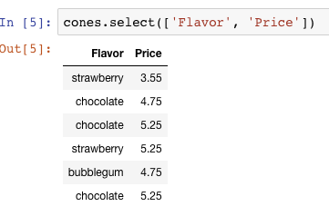
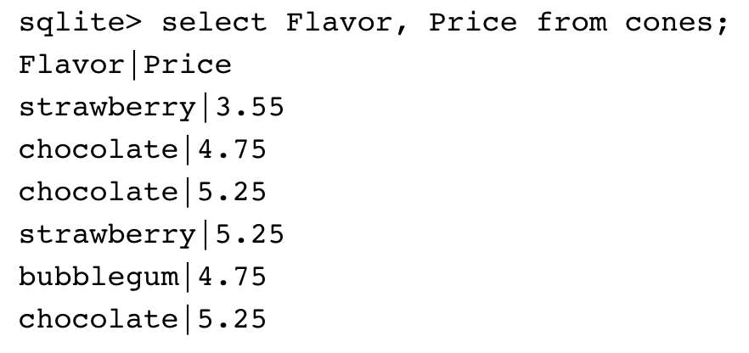
Projection
A “projection” is a view of a table, it doesn’t alter the state of the table.

Slide 18
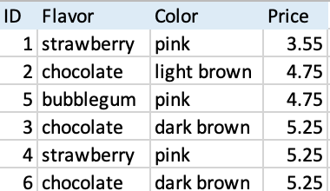
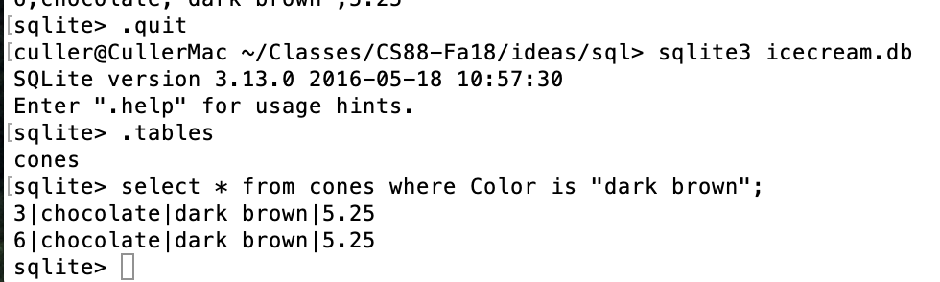
Permanent Data Storage

Slide 19
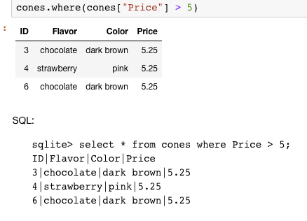
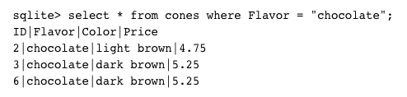
Filtering rows - where
Set of Table records (rows) that satisfy a condition
select [columns] from [table] where [condition] order by [order] ;

Slide 20
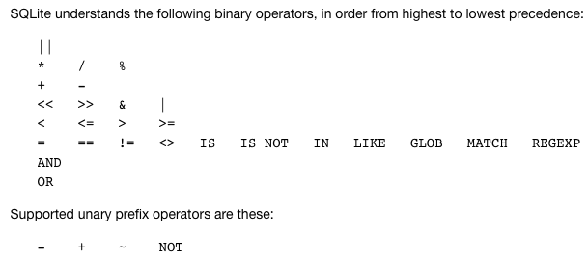
SQL Operators for predicate
use the WHERE clause in the SQL statements such as SELECT, UPDATE and DELETE to filter rows that do not meet a specified condition

Slide 21
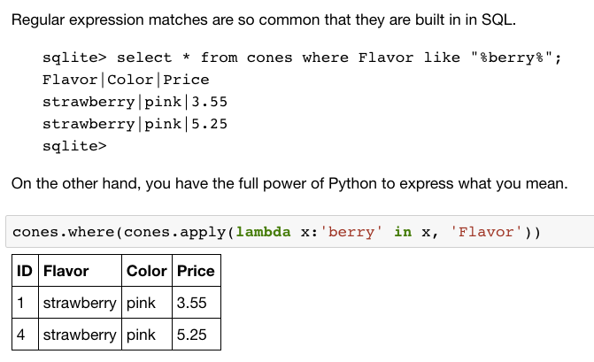
Approximate Matching …

Slide 22
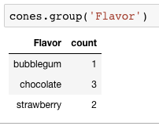
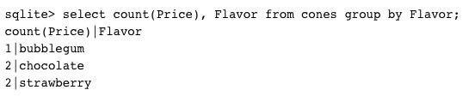
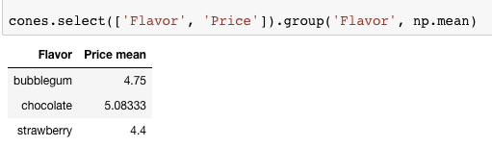
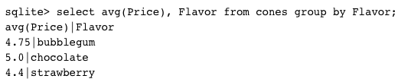
Group and Aggregate
The GROUP BY clause is used to group rows returned by SELECT statement into a set of summary rows or groups based on values of columns or expressions.
Apply an aggregate function, such as SUM, AVG, MIN, MAX or COUNT, to each group to output the summary information.

Slide 23
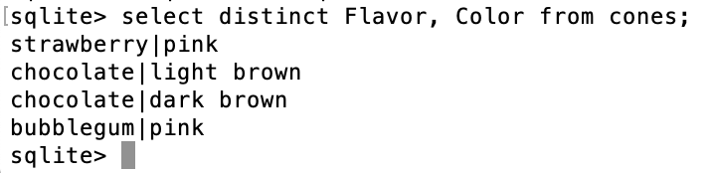
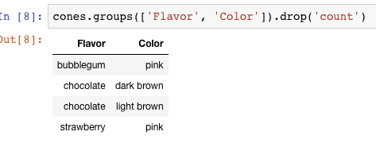
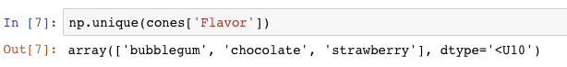
Unique / Distinct values
select DISTINCT [columns] from [table] where [condition] order by [order] ;
Built in to the language or a composable tool?

Slide 24
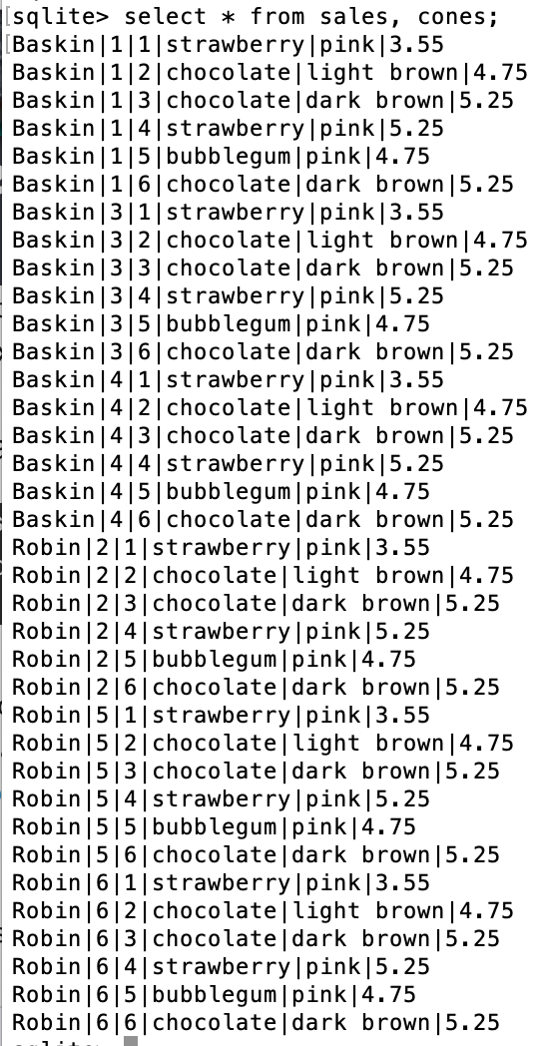
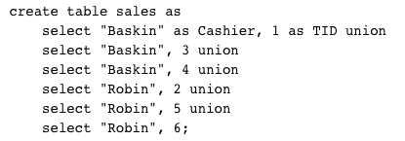
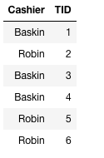
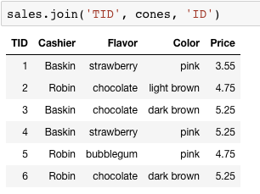
Joining tables
Two tables are joined by a comma to yield all combinations of a row from each
select * from sales, cones;

Slide 25
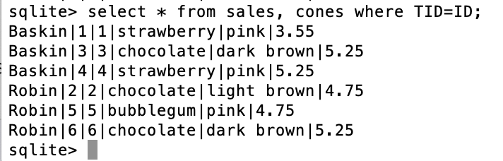
Inner Join
select * from sales, cones where TID=ID;

Slide 26
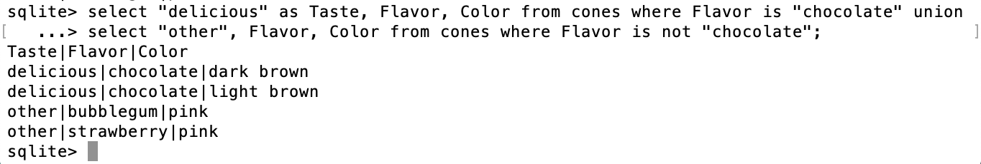
SQL: using named tables - from
select "delicious" as Taste, Flavor, Color from cones
where Flavor is "chocolate" union
select "other", Flavor, Color from cones
where Flavor is not "chocolate";

Slide 27
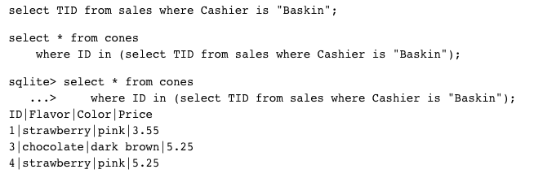
Queries within queries
Any place that a table is named within a select statement, a table could be computed
As a sub-query

Slide 28
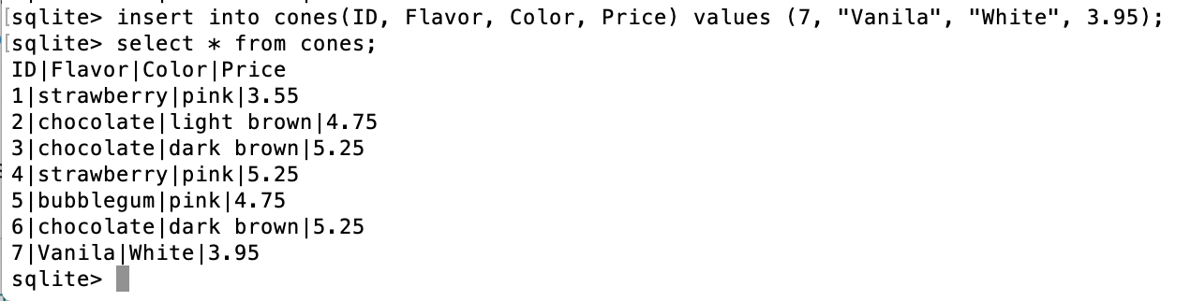
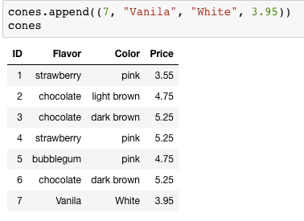
Inserting new records (rows)
INSERT INTO table(column1, column2,...)
VALUES (value1, value2,...);
A database table is typically a shared, durable repository shared by multiple applications

Slide 29
UPDATING new records (rows)
UPDATE table SET column1 = value1, column2 = value2 [WHERE condition];
If you don’t specify a WHERE, you’ll update all rows!

Slide 30
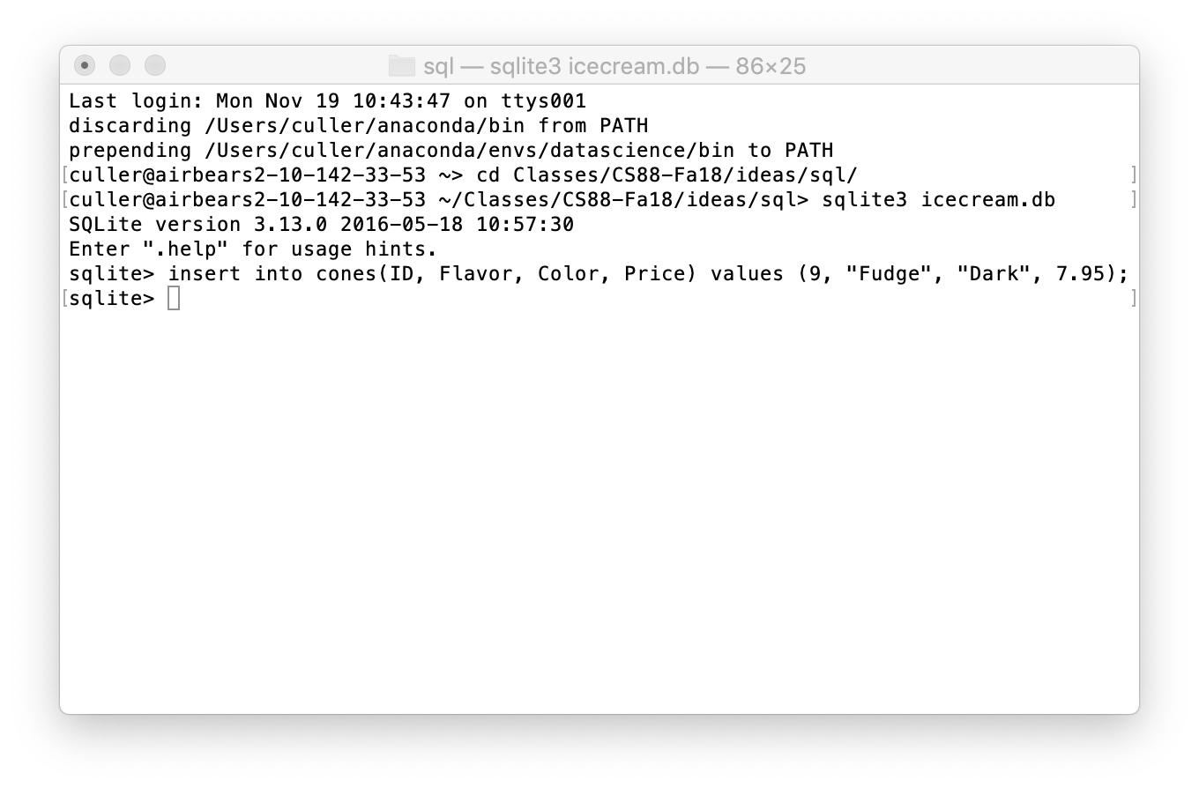
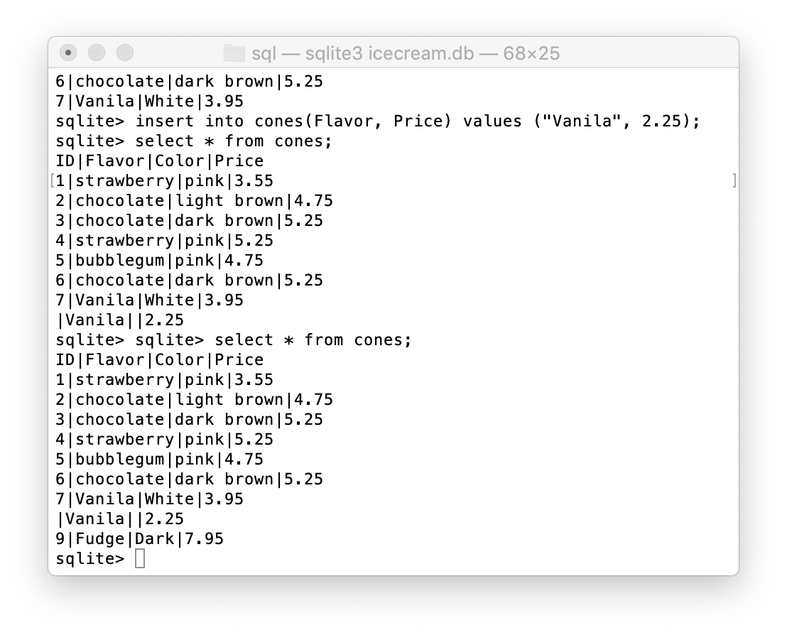
Multiple clients of the database
All of the inserts update the common repository

Slide 31
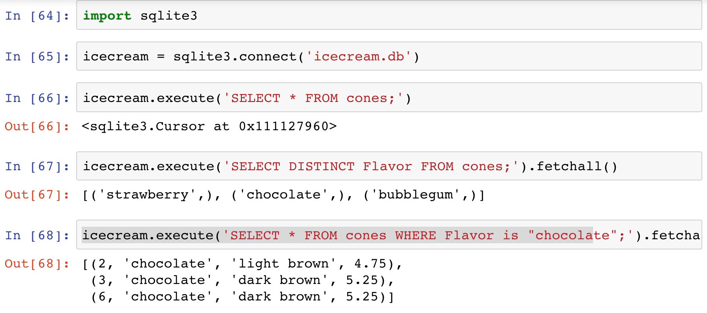
SQLite python API

Slide 32
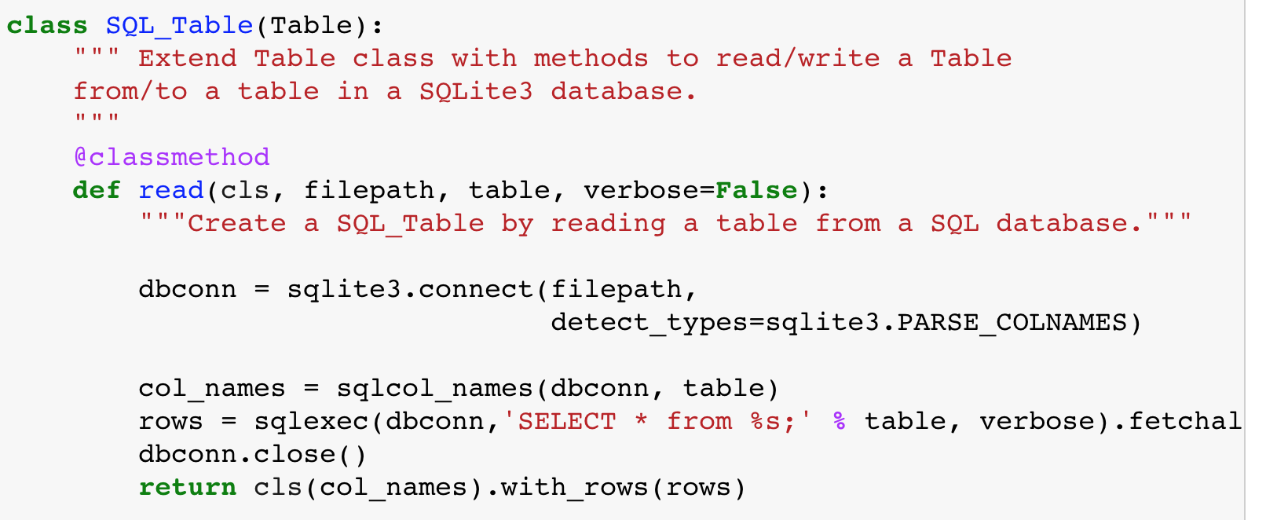
Creating DB Abstractions

Slide 33
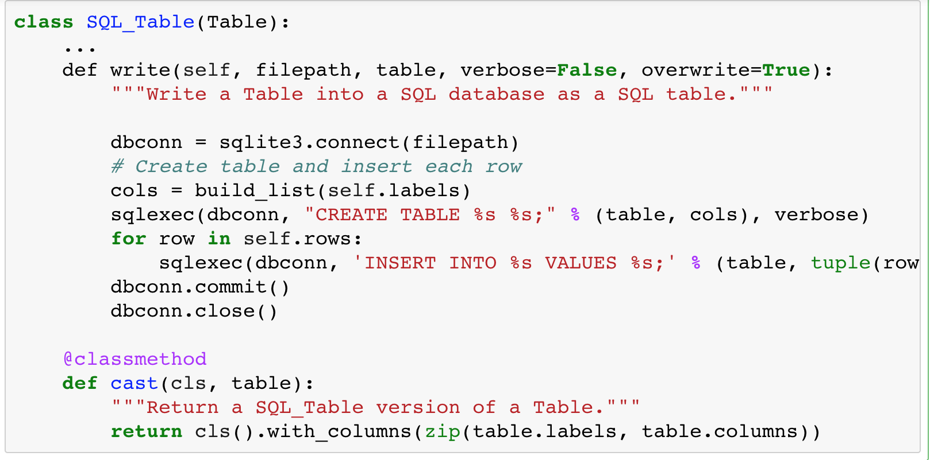
DB Abstraction (cont)

Slide 34
Summary – Part 1
SELECT <col spec> FROM <table spec> WHERE <cond spec>
GROUP BY <group spec> ORDER BY <order spec> ;
INSERT INTO table(column1, column2,...)
VALUES (value1, value2,...);
CREATE TABLE name ( <columns> ) ;
CREATE TABLE name AS <select statement> ;
DROP TABLE name ;

Slide 35
Summary
SQL a declarative programming language on relational tables
largely familiar to you from data8
create, select, where, order, group by, join
Databases are accessed through Applications
e.g., all modern web apps have Database backend
Queries are issued through API
Be careful about app corrupting the database
Data analytics tend to draw database into memory and operate on it as a data structure
e.g., Tables
More in lab

